Slide 1
NUTRITION PRIOR TO SURGERY
Colette Micko, M.S, RD, CDE
Bariatric Wellness Program Coordinator
Notes:
Hi- Welcome to our nutrition support group lecture series. My name is Colette Micko, and I am the Providence Little Company of Mary Bariatric Wellness Program Coordinator. I am also a registered Dietitian and certified diabetes educator. We hope you find these videos helpful as your begin your weight loss journey. Today we will be covering the topic of nutrition prior to surgery.

Slide 2
Project analysis slide 2
Preoperative Preparation
Research indicates that pre-surgical education by a multidisciplinary team leads to more successful outcomes after surgery.
Losing weight prior to surgery reduces surgical risk factors.
Patients who change habits related to nutrition and physical activity prior to surgery, have more success with losing weight and keeping it off.
Notes:
Pre-operative education can help you to understand that changes you will need to make after surgery. The dietitian can help you to determine you individual goals. Nutrition education on proper hydration, texture progression post-surgery, vitamin and mineral supplementation, protein requirements, meal planning and timing, appropriate macronutrient intake and distribution, mindful eating and realistic portion sizes are important topics to cover.
The purpose of pre-operative weight loss is not to “prove” that you can adhere to a diet. We know that at this point in your weight loss journey, you have tried multiple diet attempts without long term success. The goal is to improve surgical outcomes. Excess body weight (particularly fat around the liver) increases surgical risk during upper abdominal laparoscopic surgery such as sleeve and bypass.
Research shows behavior changes related to diet and exercise that are made preoperatively, increase success rates after surgery/

Slide 3
Project analysis slide 2
Preoperative Nutrition
ENERGY BALANCE
MEAL PLANNING &TIMING
Nutrition
INTAKE PATTERNS
PHSYICAL ACTIVITY
KNOWLEDGE & ATTITUDES
SOCIAL & FAMILY SUPPORT
Notes:
Today we will be exploring the purpose of good pre-operative nutrition. It’s not just about WHAT we eat. Its about understanding energy balance, current intake patterns, our current beliefs and attitudes about food, meal timing, physical activity and social/family support. It’s about WHAT we eat, WHY we eat, HOW we eat, WHEN we eat that truly impacts our daily nutrition.

Slide 4
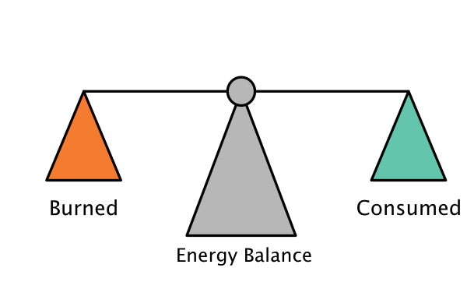
Project analysis slide 2
ENERGY BALANCE
Energy balance: the balance of calories consumed through eating and drinking compared to calories burned (through physical activity and basic metabolic functions)
Notes:
Understanding the concept of energy balance is a fundamental principle of basic nutrition.
Energy is another word for calories. Your energy balance is the balance of calories consumed through eating and drinking compared to calories burned through physical activity. What you eat and drink is ENERGY IN. What your burn through physical activity is ENERGY OUT. You also burn a certain number of calories just breathing and digesting food and through your daily routine.
An important part of ENERGY OUT is planned physical activity. Research shows regular physical activity is KEY to long term weight maintenance after surgery.
Energy imbalance may be caused by overeating or by not getting enough PA. There are other conditions, however, that affect energy balance and fat metabolism that does not involve excess eating or sedentary behavior. This includes: chronic sleep loss, consumption of foods that, independent of caloric content, cause metabolic/hormonal changes that increase body fat. This includes foods high in sugar, high fructose corn syrup, transfat, processed meat, and processed grains).
Low intake of fat fighting foods such as (fruits, vegetables, legumes, nuts/seeds/ high quality protein), stress and psychological distress, medications and even pollutants. To reiterate, some foods affect our normal hormonal processes and lead to weight gain.

Slide 5
Project analysis slide 2
ENERGY BALANCE
A balance of ENERGY IN and ENERGY OUT overtime= weight stays the same
More IN than OUT over time= weight gain
More OUT than IN over time= weight loss
Eating just 150 calories more a day than you burn can lead to an extra 5 lbs. over 6 months. That’s 10 extra lbs. per year.
Notes:
Energy is another word for calories. Your energy balance is the balance of calories consumed through eating and drinking compared to calories burned through physical activity. What you eat and drink is ENERGY IN. What your burn through physical activity is ENERGY OUT. You also burn a certain number of calories just breathing and digesting food and through your daily routine.
An important part of ENERGY OUT is planned physical activity. Research shows regular physical activity is KEY to long term weight maintenance after surgery.

Slide 6
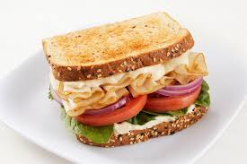
Project analysis slide 2
ENERGY BALANCE
Simple ways to cut (ENERGY IN)
1 can soda vs water
Calorie savings: -140 kcals
1 cup pasta vs 1 cup zoodles
Calorie savings: -200 kcals
Turkey sandwich vs Open face turkey sandwich
Calorie savings: -120 kcals
1 cup orange juice vs 1 medium orange
Calorie savings: -50 kcals

Slide 7
Project analysis slide 2
ENERGY BALANCE
Simple ways to burn (ENERGY OUT)
Below are a few ways to burn ~150 kcals in just 30 minutes (estimation varies based on weight)
Shoot hoops
Walk 2 miles
Do yard work
Go for a bike ride
Dancing

Slide 8
Project analysis slide 3
ENERGY BALANCE
SELF MONITORING
MINDFUL EATING
BALANCED MEALS
REGULAR EXERCISE
MEAL PATTERN
Mindfulness is described as focusing on the present moment, while acknowledging and accepting your feelings, thoughts, and bodily sensations without judgment..
Balanced meals pre and post surgery should emphasize lean protein, whole fruits and vegetables, whole grains/legumes and healthy fats.
Following a regular meal pattern or schedule with no skipped meals is key to long-term success. It helps to regular blood sugar, appetite, and prevent overeating
Establishing regular exercise patterns (including light aerobic conditioning and resistance training) for at least 20 minutes/day for 3-4 days/week improves surgical outcomes.
Observing and recording eating and exercise patterns, followed by self reflection or feedback on the behaviors.
Notes:
One of the most proven behavioral intervention strategies for weight management for lifestyle changes is self-monitoring. The goal of self-monitoring is to increase self-awareness of target behaviors and outcomes,. Some commonly used self-monitoring: food diaries, regular self-weighing, exercise logs, equipment such as pedometers or Fitbit.
Most Americans have mastered eating while doing something else (working, driving, reading, watching TV, fiddling on our smart phone)- thus we are not fully aware of what we are eating. This lack of mindfulness is also called mindless eating and research shows- mindless eating is associated with excess calorie consumption and obesity. By taking a few steps to incorporate basic mindful eating principles- you can slowly reduce calorie intake over time. Some basic principles include: come to the table with an appetite (not ravenously hungry). Sit down for meals and minimize distractions. Take a moment between bites to appreciate your food. Take small bites and chew slowly (these are also principles to minimize discomfort after bariatric surgery).
Balanced meals are key to regulating appetite and blood sugars. Pre and post surgery, balanced meals should emphasize lean proteins (such as chicken, fish, eggs, low-fat/non fat dairy) and high fiber fruits/vegetables, whole grains. Protein and fiber digest slower in the body than simple sugars and carbohydrates- thus you feel fuller longer. Simple way to think about it- fill ½ your plate with non-starchy vegetables, ¼ protein, ¼ fruit or complex CHO. Minimize intake of beverages with sugar.
Contrary to what you might believe, the heavier is person is, the less often they eat. A high percentage of our patients skip breakfast and eat 1-2 large meals per day. After surgery, it will be impossible to meet your daily protein goals in a matter of 1-2 meals- so establishing a regular meal pattern beforehand (and aiming to meet protein targets) is key.
The American Society for Metabolic and Bariatric Surgery recommends mild exercise pre-operatively to improve cardiovascular fitness, reduce risk of surgical complications, facilitate healing and enhances post-operative recovery.

Slide 9
Project analysis slide 4
Balanced Meals
Before Surgery
½ plate non-starchy vegetables, ¼ protein, ½ starch or fruit
After Surgery
Eat 2-3 oz. protein rich food first
Choose non-starchy vegetables second
If still hungry, eat high fiber fruit/whole grain

Slide 10
Thank You

