Slide 1
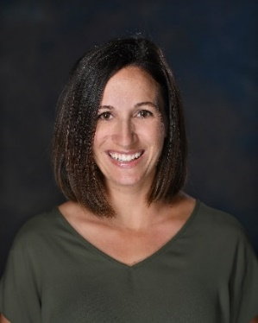
Nutrition after surgery
Colette Micko, MS, RD, CDE
Bariatric Wellness Program Coordinator
Notes:
Hi- Welcome to our nutrition support group lecture series. My name is Colette Micko, and I am the Providence Little Company of Mary Bariatric Wellness Program Coordinator. I am also a registered Dietitian and certified diabetes educator. Today we will be covering the topic of nutrition after surgery. This is meant to serve as a brief overview/understanding of required changes expected after surgery. It is not meant to take place of individualized nutrition counseling that takes place in the pre-operative period.

Slide 2
Overview of presentation
Review of diet progression after surgery
Review Bariatric Nutrition “Golden Rules”

Slide 3
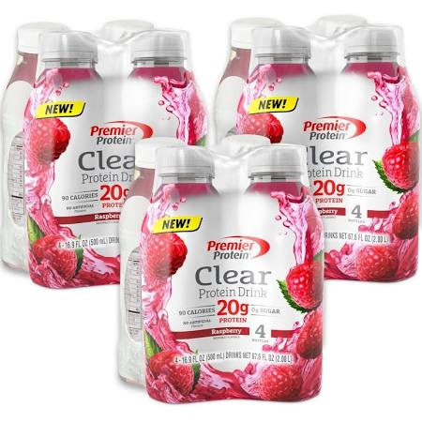
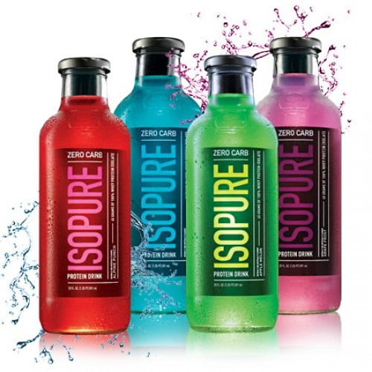
Phase I: thin liquids: Lasts 7-10 days
GOALS: 80-120g protein, 48-64oz fluid
Protein Shakes
Consider volume and quality of protein source
AVOID collagen-based proteins
Double check brand for-
>15g protein and <10g carbs/serving
Max 200 calories for a Ready-to-drink shake
Very few calories
NO CARBONATION
NO SUGAR
NO CAFFEINE (at least for first 30 days)
NO ALCOHOL
Be cautious of lactose intolerance

Slide 4
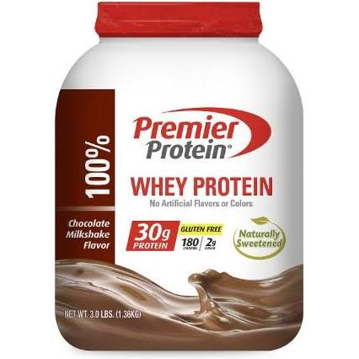
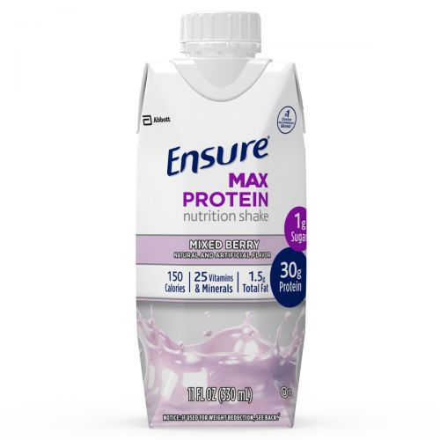
Phase II: Thick liquids: Lasts 7-14 days
GOALS: 80-120g protein, 48-64oz fluid
Example Foods Include:
Low-Fat blenderized soup
Nonfat milk (or lactose-free alternative)
Protein shakes
>15g protein and <10g carbs/serving
Runny Cream of Wheat
add water, fat-free milk or unflavored protein powder
Sugar free, fat-free ice cream
Anything from Phase I
Same restrictions as Phase I
No carbonation
No sugar
No caffeine
No alcohol

Slide 5
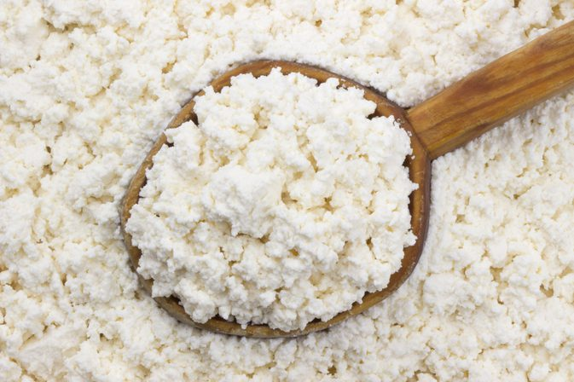
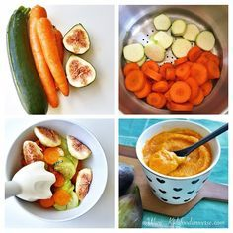
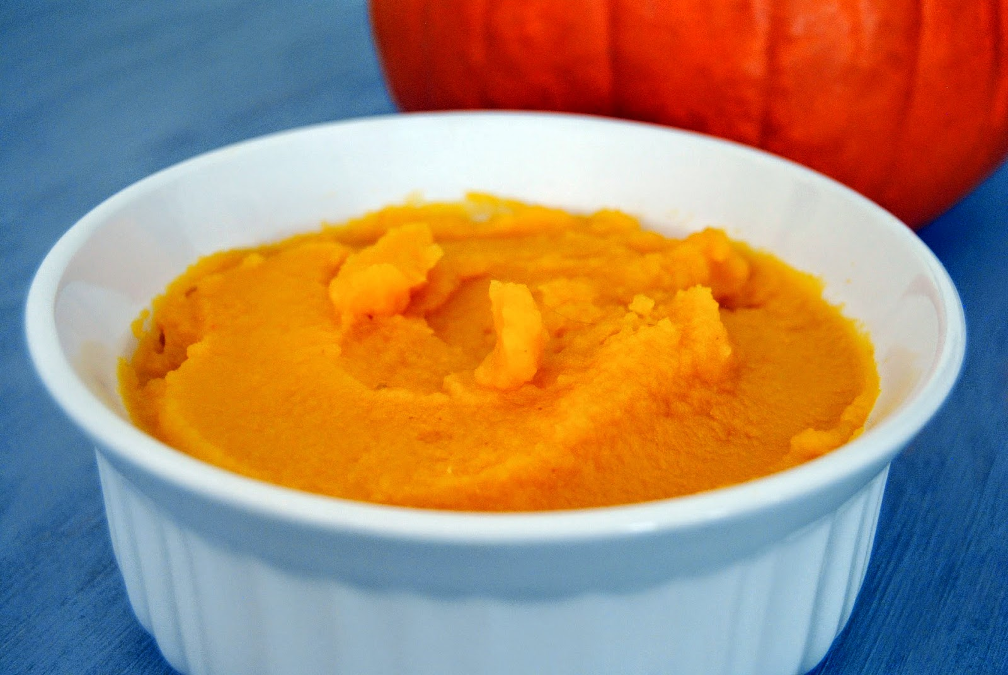
Phase III: Puree: Lasts 7-14 days
GOALS: 80-120g protein, 48-64oz fluid
Example Foods Include:
Low Fat Soups: Blenderized*
Runny Cream of Wheat or pureed oatmeal*
Pureed chicken, fish and turkey with broth
Pureed vegetables and unsweetened fruits*
Small curd, low fat cottage cheese
Nonfat, plain Greek yogurt or low sugar yogurt
Icelandic yogurt is a good alternative too
*Add unflavored protein powder
Whey, Soy or Egg white – to foods that are not naturally good sources of protein
Advance as tolerated

Slide 6
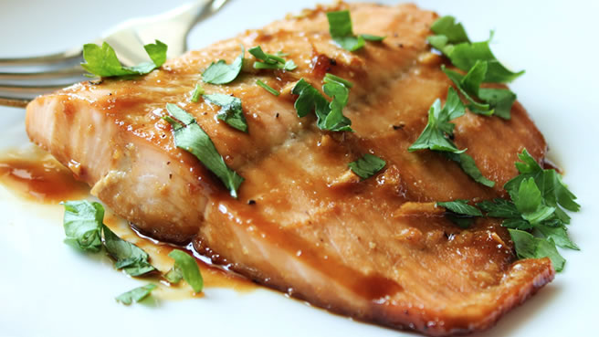
Phase IV: soft Foods: Lasts 14-21 days
GOALS: 80-120g protein, 48-64oz fluid
Food that can be easily mashed with a fork
Example Foods Include:
Canned chicken or tuna with light mayo
Ground and chopped tender cuts of meats or meat alternatives
Steamed or poached fish
Cottage cheese or Greek/Icelandic yogurt
Low fat cheeses (string cheese)
Soft cooked vegetables
DO NOT DRINK WITH MEALS (30 min before/30 min after)
Emphasis on protein & fluids
Advance as tolerated

Slide 7
Phase V: Maintenance
Goals:
3 meals with 1-2 snacks
Ok to start with 5-6 small meals
80-120g protein, 64ounces fluid daily
Take small bites; chew food thoroughly
Avoid simple carbs (concentrated sugars)
DO NOT DRINK WITH MEALS (30 min before/30 min after)
Keep a Food Journal
Add one new food at a time
Track amount of protein consumed, ounces of water and tolerance of foods
MyFitness Pal App, Baritastic App, Lose It App, Personal Journal

Slide 8
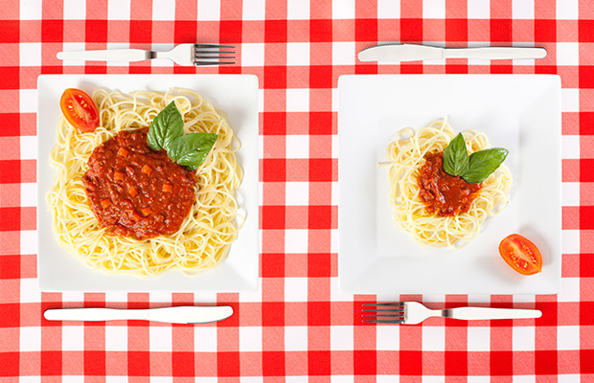
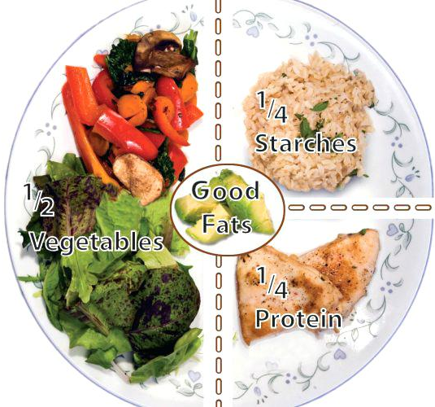
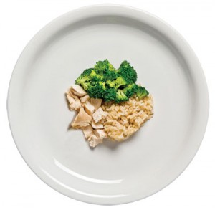
Healthy eating Before and after surgery
MyPlate Example
Vegetables/Fruit SECOND
Starches LAST
Protein FIRST
Before
Choose the right balance of lean protein, fiber rich grains, and colorful fruits and vegetables.
After
Focus on high-quality protein, then add vegetables, some fruit, and a small amount of starch or grain

Slide 9
Bariatric NUTRITION Golden Rules
Eat at planned times
Don’t skip meals
3 meals +/- 1 or 2 planned snacks
Allow 20-30 minutes/meal
Take your Vitamins FOREVER

Slide 10
Bariatric Nutrition Golden Rules
Sip wisely and slowly throughout the day
Goal is 64 fluid ounces per day
At least 32 ounces should be plain water
Other fluid sources; protein supplements, soup/broth, other low-calorie/calorie free beverages, herbal/decaf tea
Avoid carbonated beverages
They will lead to excess gas and possibly stretch the stomach
Avoid caffeine for at least 30 days
Avoid alcohol for at least 6 months
Alcohol can cause stomach ulcers, liver damage, dumping syndrome
High in empty calories
Alcohol may affect you differently after surgery

Slide 11
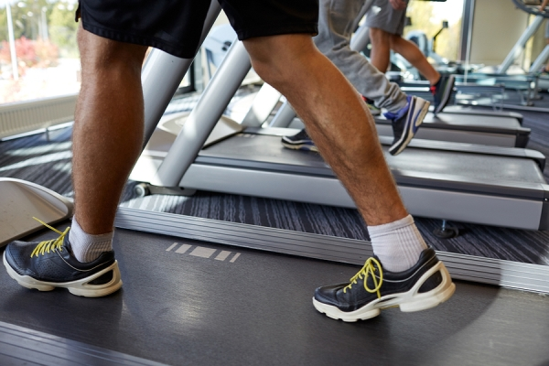
Bariatric Nutrition Golden Rules
Exercise
Goal: at least 30 minutes moderate-intensity activity, 5 days per week
Start slowly – increase as tolerated
Do cardio most days- to increase cardio/pulmonary capacity
Walking, swimming, dancing, cycling
Try chair exercises if mobility is limited
After surgery, strength train 2-3 days per week (with MD ok)
Resistance training, working with personal trainer, Yoga, Pilates, etc.
Maintenance Goal is 250 minutes/week (4 hours)
People who begin exercising before surgery may have greater weight loss success after surgery.
Continued exercise helps keep the weight off long-term

Slide 12
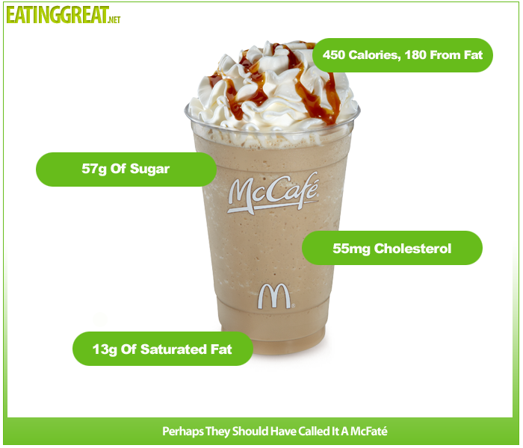
Bariatric Nutrition Golden Rules
Avoid concentrated sweets & refined carbs
Eating too much of these foods will leave little room for other more important nutrients, such as protein, vitamins and minerals
Examples to avoid – baked goods, candy, donuts, sauces with sugar, sugary beverages, sports drinks, breakfast cereals, dried fruit, and fruit juices
Dumping syndrome
Symptoms - bloating, cramps, diarrhea, lightheadedness, fast heart rate, and heavy sweating
Empty Calories
Minimize artificial sweeteners
Splenda, Equal, NutraSweet
May trigger more sugar cravings

Slide 13
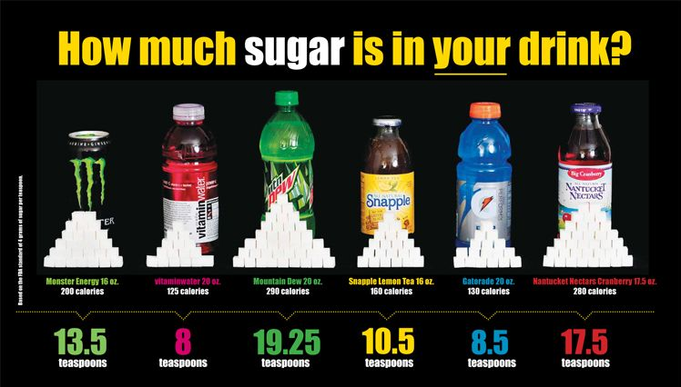
Practical tips:
DO NOT drink your calories!!
Liquids will pass through the reduced stomach pouch quickly and you will not feel full
This is also a common way to gain back your weight
AVOID:
High calorie drinks
Special coffee drinks
Beverages made with sugar, soda, alcohol, milkshakes
Juices/smoothies limit to 4 ounces per day

Slide 14
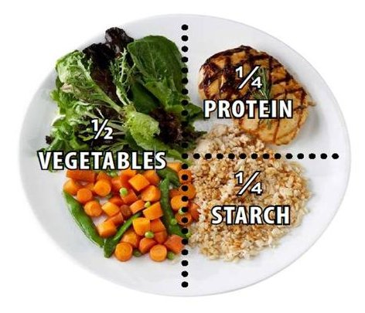
Bariatric Nutrition Golden Rules
Remember to chew!
Take very small bites – you may fill up quickly
Chew to applesauce consistency
Swallow small amounts at a time.
Eat a balanced diet
Try to eat foods closest to their original form
Use the MyPlate example
MyPlate Example

Slide 15
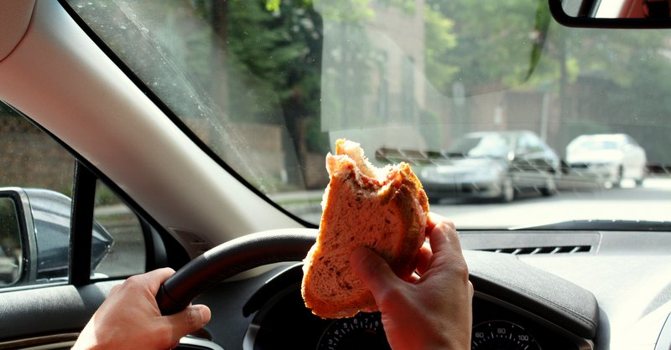
Bariatric Nutrition Golden Rules
Listen to your body
Stop eating at the first sign of fullness or satisfaction.
Eliminate mealtime distractions

Slide 16
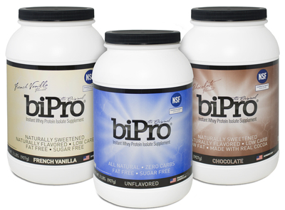
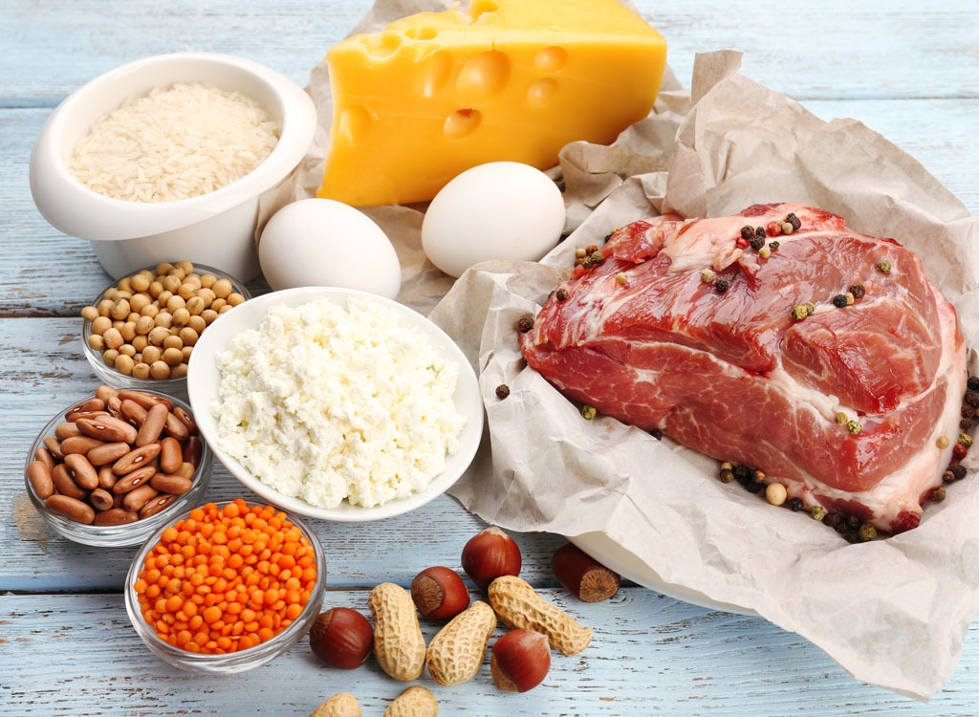
Bariatric Nutrition Golden Rules
Get in enough Protein!
80-120grams of protein daily
1 ounce of protein food = 7 grams of protein
Protein rich foods:
Lean meat – Fish, chicken, turkey, pork, eggs
Dairy – low fat cheese, cottage cheese, Greek yogurt, Milk
Plant based – Soy products, lentils, beans, tofu
Supplementation – BiPro, Premier Protein, Isosource

Slide 17
THANK YOU

